Slide 1
Internal Capital Markets in Times of Crisis: The Benefit of Group Affiliation
Raffaele Santioni Bank of Italy
Fabio Schiantarelli Boston College
Philip E. Strahan IZA, and NBER
Presented by Austin Francis

Slide 2
Research Question
What is the role of internal capital markets within business groups during times of financial crisis, and how do these internal capital transfers affect firm survival, particularly when external markets (like banks) are distressed?

Slide 3
Prior Literature
Internal Capital Markets during Crises: Previous research has shown that internal capital markets become more important during financial crises. Studies by Matvos and Seru (2014), Almeida, Kim, and Kim (2015), and Kuppuswamy and Villalonga (2015) have explored this dynamic, demonstrating that group-affiliated firms are better able to survive because of access to internal capital.
Diversified Firms and Survival: Studies have shown that diversified conglomerates, like those in the U.S., tend to perform better during crises due to their ability to share resources (e.g., Matvos, Seru, and Silva, 2018). Similarly, work on Korean and Indian business groups shows that intragroup transfers are used to reallocate capital where it’s needed most.
Bank Credit and Financial Shocks: Studies on the effects of bank distress on firms, such as by Cingano, Manaresi, and Sette (2016) and Popov and van Horen (2015), reveal that external financing constraints can severely limit firm performance, but the internal capital market acts as a buffer in such times.

Slide 4
Hypothesis
Firms that are part of business groups will have higher survival rates during financial crises due to their access to internal capital markets. These firms will be less affected by bank distress compared to unaffiliated firms.

Slide 5
Key Metrics
Firm survival: The probability of a firm surviving during and after a crisis period.
Bank health: Measured using the ratio of bad loans to total assets for the firm’s lending banks.
Intragroup financial transfers: Measured as the amount of financial debt transferred between firms within the same group.
Cash flow: Both firm-level and group-level cash flows, as a measure of internal financial resources.
Sales growth: Used to proxy for investment opportunities within a firm.

Slide 6
Results
Group-affiliated firms are about 6 percentage points more likely to survive during the 2008 financial crisis compared to unaffiliated firms.
The effect of a firm’s bank health on its survival is smaller for group-affiliated firms, proving that internal capital markets helped buffer the effects of external credit shocks.
Internal transfers within groups increased significantly during times of financial stress, especially when external financing options (like bank loans) became more limited.

Slide 7
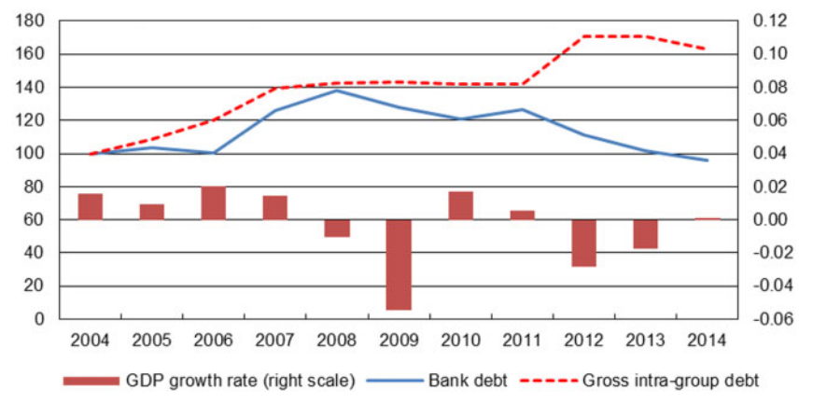
Notes:
Figure 2 shows this pattern at an aggregate level: intragroup capital transfers increase sharply as the euro area sovereign debt crisis explodes in 2011, and this increase is mirrored by a drop in outside borrowing (mainly from banks). Analysis of firm-level data supports this substitution. First, intragroup capital flows from firms with high cash flow to those with low cash flow and also toward firms with high investment opportunities (proxied by sales growth).

Slide 8
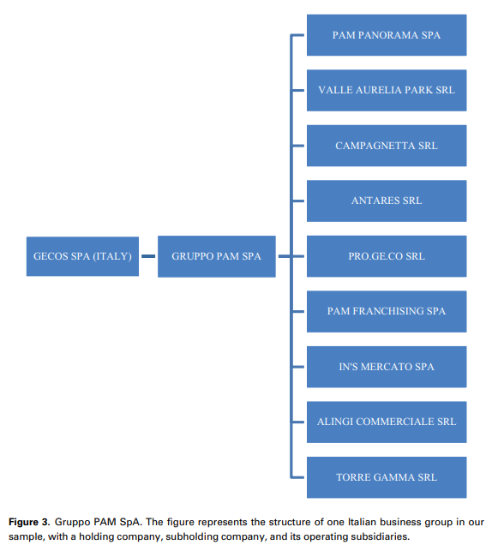
Notes:
Example of a business group

Slide 9
Data Collection
Gruppi Italiani data by Cerved for information on the entire universe of Italian groups.
Centrale Dei Bilanci by Cerved for income statement and cash flow statement
Firm level loan data from the Italian Credit Register

Slide 10
Data Collection
Ownership is assigned as follows: 2006 ownership data for all firms from 2004-2007; 2010 information is for 2008-2011; and the 2014 ownership data is assigned to the years 2012-2014

Slide 11
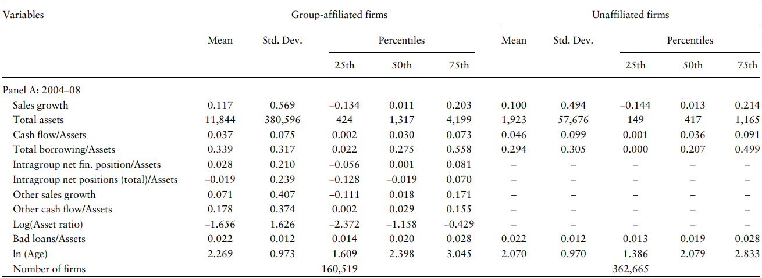
Table 1 – Summary Statistics
Notes:
What it seeks to prove: It aims to show the basic differences between group-affiliated and unaffiliated firms before and during the financial crisis, including firm size, performance, and borrowing behavior.
Three main takeaways:
Group-affiliated firms are larger and more likely to borrow internally. TOTAL ASSETS, MEAN AND MEDIAN
Both group-affiliated and unaffiliated firms saw declines in performance during the crisis.
Group-affiliated firms had more access to internal funding than unaffiliated firms. For the group-affiliated firms, This tablealso shows how Intragroup Net Financial Position/Assets varies across firms and over time. As expected, the median value is near zero, which follows from the fact that the measure nets up to zero within each group

Slide 12
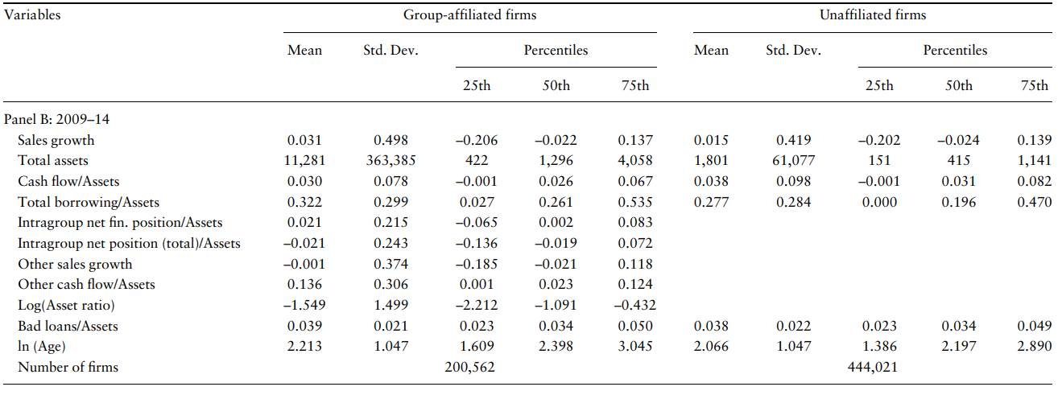
Table 1 – Summary Statistics
Notes:
What it seeks to prove: It aims to show the basic differences between group-affiliated and unaffiliated firms before and during the financial crisis, including firm size, performance, and borrowing behavior.
Three main takeaways:
Group-affiliated firms are larger and more likely to borrow internally.
Both group-affiliated and unaffiliated firms saw declines in performance during the crisis.
Group-affiliated firms had more access to internal funding than unaffiliated firms.

Slide 13
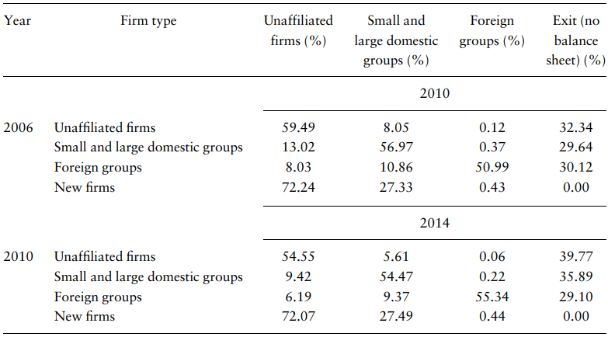
Table 2 – Transition Matrix for the universe of Italian firms
Notes:
What it seeks to prove: It tracks the changes in firm ownership and status over time, showing how many firms remained independent, joined groups, or exited the market.
Three main takeaways:
Most firms remained in the same category (group-affiliated or unaffiliated) over time.
The rate of firms exiting the market increased during the crisis.
Group-affiliated firms were more likely to stay active compared to unaffiliated firms. EXIT % - Higher for unaffiliated firms

Slide 14

Model

Slide 15
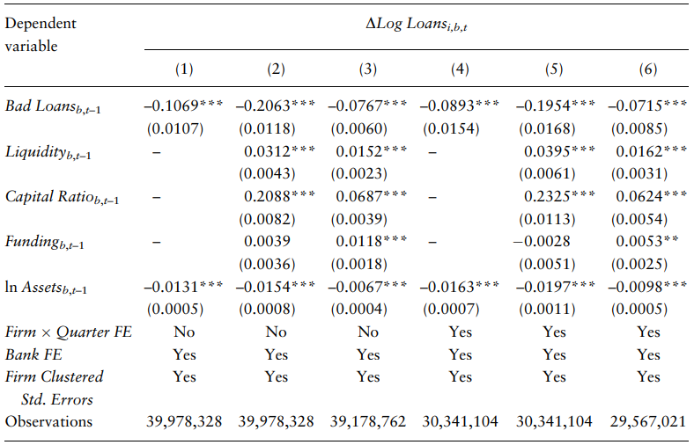
Table 3 – Bank loan supply growth
Notes:
To validate the idea that exposure to Bad Loans really has reduced credit supply, This table shows regressions of the growth in new credit origination at the bank–firm–quarter level, based on loan growth from the Credit Register. What it seeks to prove: It examines how bank health (especially bad loans) impacts the supply of credit to firms, particularly those borrowing from multiple banks.
Three main takeaways:
Banks with high levels of bad loans reduced their credit supply.
Firm credit growth was negatively affected by their lenders’ financial problems.
The availability of bank credit was critical for firms' financial health during the crisis. Bad loans coefficient. More bad loans leads to a reduction in credit supplied by banks As shown, lenders saddled with high levels of loan losses cut credit growth. The magnitude of the effect of Bad Loans changes somewhat across specifications (smaller when we drop the outliers), but the sign is always negative with very strong statistical significance.16

Slide 16

Survival Model

Slide 17
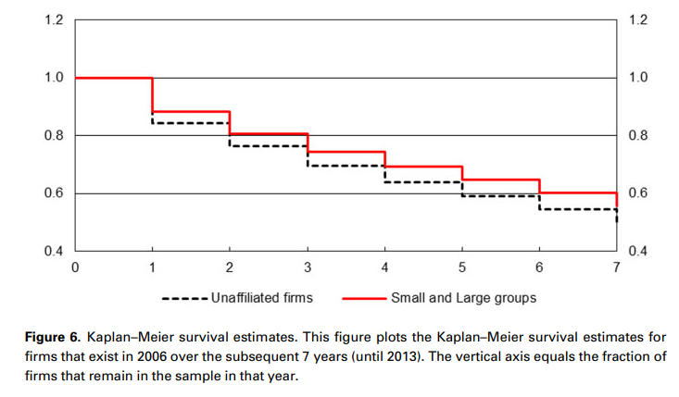

Slide 18
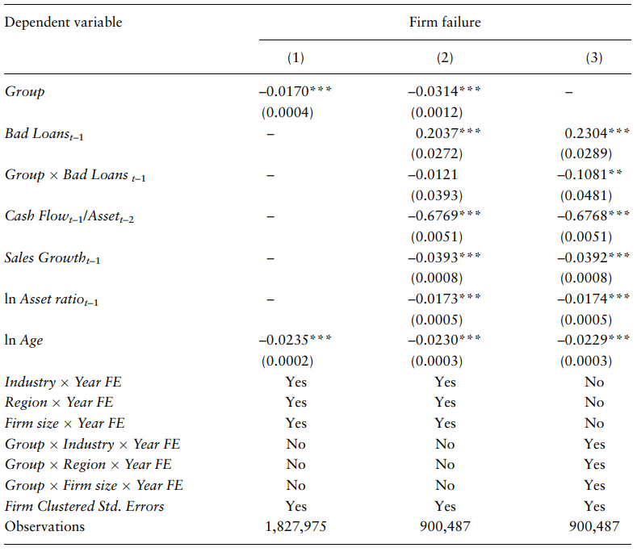
Table 4 – Firm Failure by Group Affiliation
Notes:
What it seeks to prove: It tests whether group affiliation helped firms survive during the financial crisis, considering both internal group cash flow and external bank health.
Three main takeaways:
Group-affiliated firms had a lower probability of failure compared to unaffiliated firms.
A firm's survival depended less on its bank’s health if it was part of a group.
Internal capital transfers played a significant role in ensuring firm survival. Being in a group reduces the annual probability of failing by 1.7% each year

Slide 19
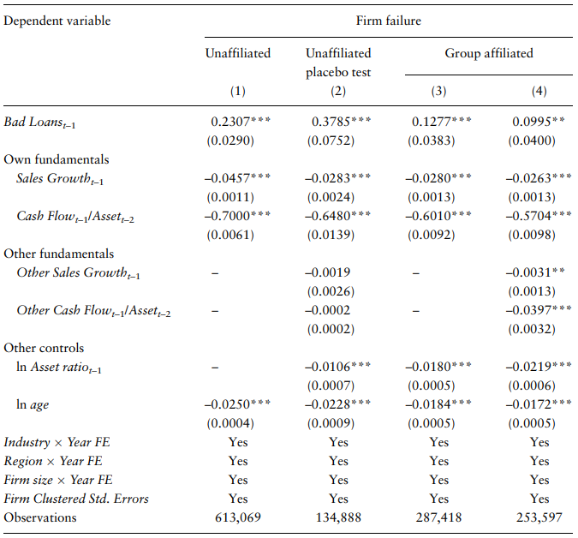
Table 5 – Firm Failure and Group-level Cash Flow and Sales Growth and Bank Health
Notes:
Firms placed in psuedogroups as a placebo When “brother and sister” firms have high sales and/or substantial cash flow, this firm is less likely to fail. In other words, comparing two group-affiliated firms with similar fundamentals, the one with access to a stronger internal capital market is more likely to survive. a standard deviation increase in Other Cash flow (¼0.306) leads to a decline in annual failure rates of 0.12%. What it seeks to prove: It explores the impact of group-level cash flow and sales growth on the likelihood of firm survival, especially during the crisis period.
Three main takeaways:
Firms with strong group-level cash flow were more likely to survive.
The effect of group-level cash flow was stronger during periods of bank distress.
Sales growth within the group also improved survival rates for affiliated firms.

Slide 20
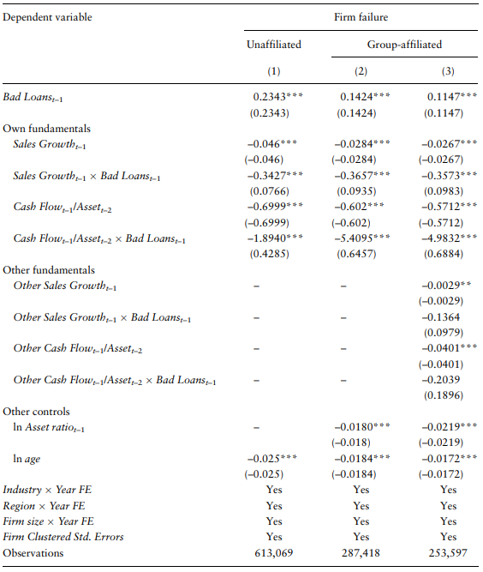
Table 6 – Firm Failure and Group-level Cash Flow and Sales Growth and Bank Health
Notes:
What it seeks to prove: It extends the survival model by breaking down differences between group-affiliated and unaffiliated firms, showing how these groups fared differently during crises.
Three main takeaways:
Group-affiliated firms consistently outperformed unaffiliated firms in terms of survival.
Access to internal capital mitigated the risks from poor bank health.
The survival advantage for group-affiliated firms was consistent across industries. To be precise, the effect of a firm’s own fundamentals becomes substantially stronger when its banks are distressed. That is, both own Sales Growth and own Cash Flow interact negatively with Bad Loans. Said differently, firms are most likely to fail when their own fundamentals are weak and access to external capital is constrained. Yet the results also continue to show that unaffiliated firm survival depends more on its bank health than that of group-affiliated firms. Together, the results of Tables IV–VI suggest that group affiliation helps firms survive by increasing their potential to share funds between firms owned by the same group. And, crucially, that group-affiliated firm survival depends less on the health of their banks, consistent with internal capital markets providing a substitute source of funds.

Slide 21
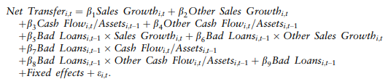
Net Transfer Model

Slide 22
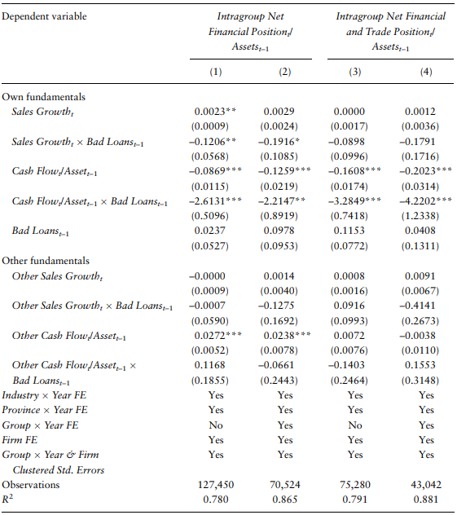
Table 7 – Intragroup Capital Transfers and Bank Health
Notes:
What it seeks to prove: It examines how firms within a group transfer capital internally, especially in response to external financial constraints (like bank distress).
Three main takeaways:
Internal transfers increased when banks were in distress.
Capital flowed from cash-rich to cash-poor firms within the group.
Firms with higher sales growth received more internal capital. . Positive coefficients indicate that an increase in the explanatory variable leads a firm to use more funds from the internal capital market (i.e., to borrow), whereas negative coefficients mean that an increase in the explanatory variable leads the firm to supply more funds to the internal capital market (to lend). Both Cash Flow and Other Cash Flow affect capital transfers strongly: firms with high cash flow lend to the internal capital market and those with low cash flow borrow;

Slide 23
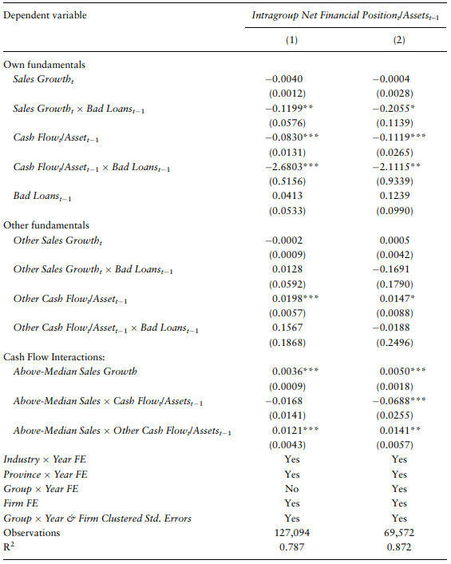
Table 8 – Intragroup Capital Transfers and Bank Health
Notes:
What it seeks to prove: It focuses on the efficiency of internal capital markets, particularly how well firms allocate resources during financial crises.
Three main takeaways:
Internal capital transfers were directed toward firms with better investment opportunities.
The efficiency of these transfers improved during the crisis.
Firms in groups with strong internal capital markets fared better in the downturn.
Positive = Borrow Negative = Lend adding an indicator variable equal to one for firms with abovemedian sales growth for that year and its interaction with the two cash flow variabes (own and other) Efficiency in the internal capital market would imply that low cash flow firms with high sales ought to receive more intragroup transfers than low cash flow firms with low sales. In other words, Above-Median Sales Cash Flow ought to enter negatively. The opposite would be true for other cash flow, meaning that Above-Median Sales Other Cash Flow ought to enter positively

Slide 24
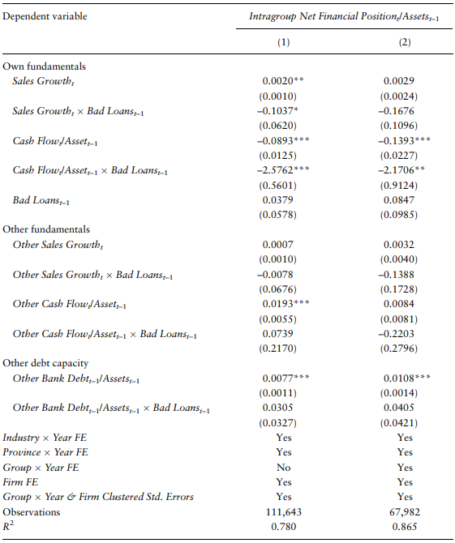
Table 9 - Intragroup Capital Transfers and Debt Capacity
Notes:
What it seeks to prove: It explores how internal capital transfers within groups are affected by firms' debt capacity and fundamentals during the crisis.
Three main takeaways:
Firms with better fundamentals and higher debt capacity received more internal capital.
Internal capital markets helped firms avoid external borrowing.
Debt capacity was an important determinant in capital allocation decisions. Positive = Borrow Negative = Lend
Other Bank Debt enters significantly with a positive effect, meaning firms borrow from the internal capital market when their “brother and sister” firms have greater access to external capital. They do not find, however, that this effect interacts with the health of the firm’s banks

Slide 25
Conclusion
Group-affiliated firms are about 6 percentage points more likely to survive during the 2008 financial crisis compared to unaffiliated firms.
The effect of a firm’s bank health on its survival is smaller for group-affiliated firms, proving that internal capital markets helped buffer the effects of external credit shocks.
Internal transfers within groups increased significantly during times of financial stress, especially when external financing options (like bank loans) became more limited.

